Slide 1
Cornwall Learning Disability Partnership Board review 2023

Slide 2
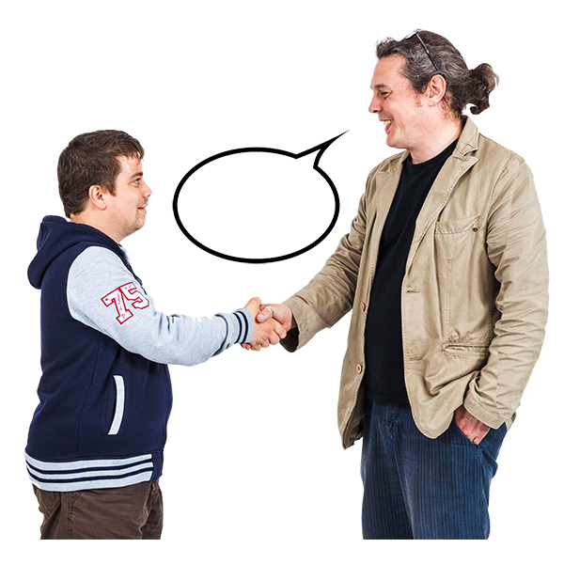
Welcome!
Notes:
This session is being run as part of a review the partnership board members decided to do
Learning Disability England have helped plan the review and will coordinate the work. They will also run 1 open session that will look at these questions too

Slide 3
What today is about
How can the Board make a difference to the lives of people with learning disabilities, autistic people and their families in Cornwall?
How can the Board be connected to other groups and work in Cornwall so that it sees the bigger picture?
How should the Board actually work to do a good job?

Slide 4
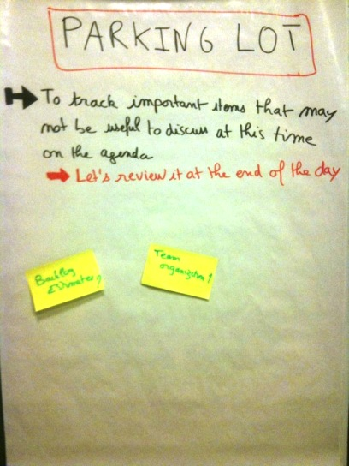
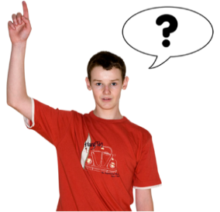
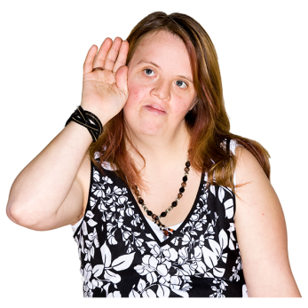
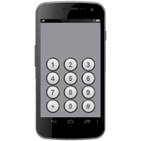
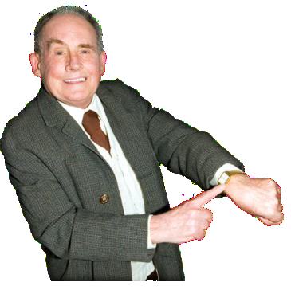
Working together
Big words
Jargon
Notes:
Here’s how we say we work together
Help everyone take part by using easy words and no jargon.
Please treat each other with respect – one person speaking at a time, listening is important too
You can use a red traffic light card if you have one
Phones should be off or on silent
We have a lot to get through – please help us keep to time
what’s said in the room should stay in the room
All the feedback you give will be anonymous, we will not use your name or information that could identify you

Slide 5
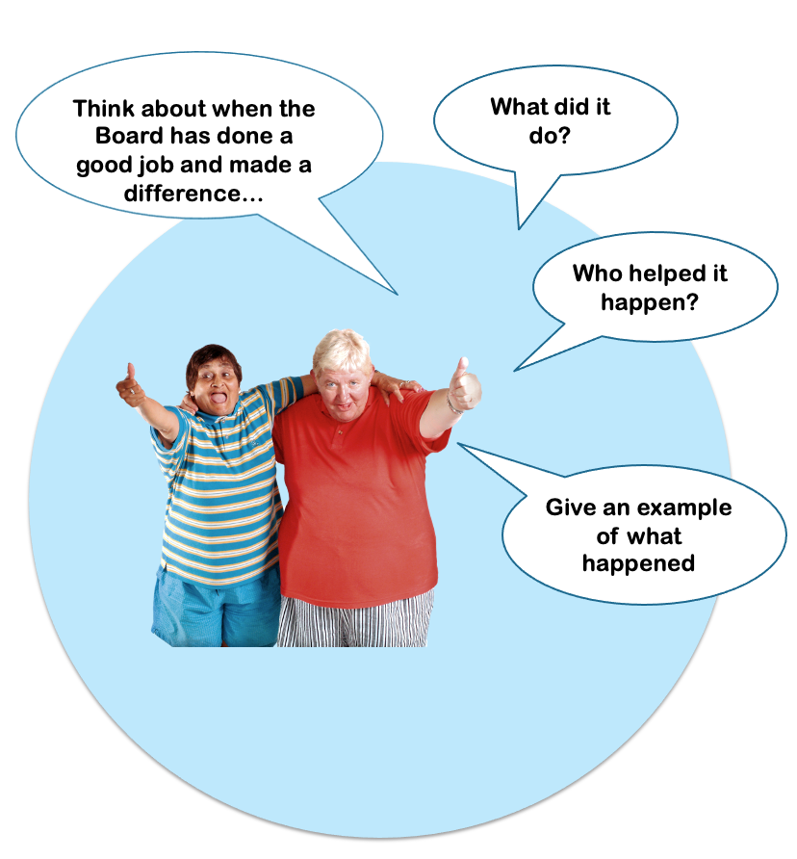
What has been good about the Partnership Board so far?

Slide 6
How can the Partnership Board
make a difference?

Slide 7
How can the Partnership Board be part of the bigger picture?

Slide 8
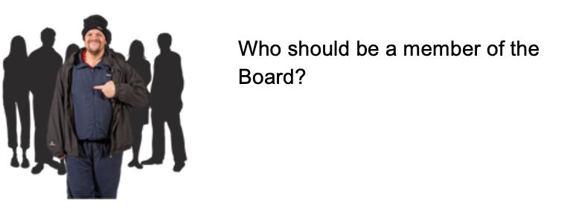
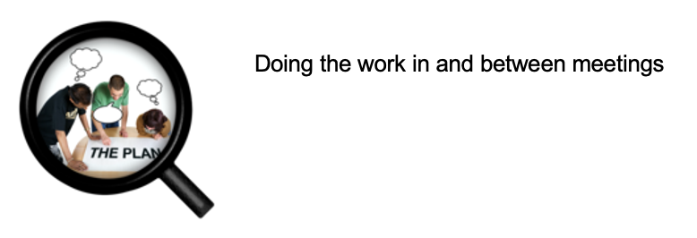
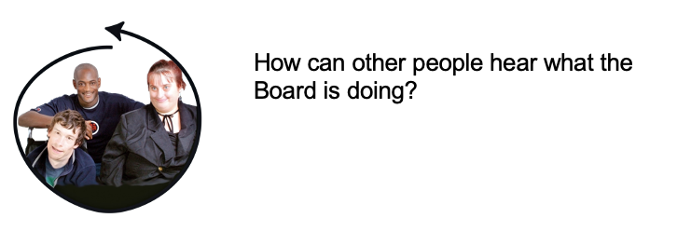
How should the Partnership Board
Work to do a good job?
Co Chairing by someone with a learning disability who helps lead the meetings and make decisions

Slide 9
If I ruled the world ….

Slide 10
Checking the parking lot….

Slide 11
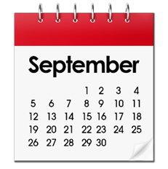
Next steps
Learning Disability England will organise all the ideas and feedback from the local meetings and other feedback.
A small group from the Partnership Board will work with Learning Disability England to check all the ideas and work out what is important to do next.
This small group will write a draft plan for
How the Board meetings work and rules for the future
How the Board is part of the bigger picture and is connected to other people or groups
How the Board really makes a difference
The plan is that the Partnership Board is ready to work in a new way in September 2023.

Slide 12
Thank you and safe journey!
Notes:
Gary (Or Sam?)

