Slide 1
How should the Partnership Board work to do a good job?
Who should be a member of the Board?

Slide 2
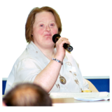
How should the Partnership Board work to do a good job?
Leadership and Co-Chairing by someone with a learning disability

Slide 3
How should the Partnership Board work to do a good job?
Doing the work in and between meetings

Slide 4
How should the Partnership Board work to do a good job?
How can other people hear what the Board is doing?

