Slide 1
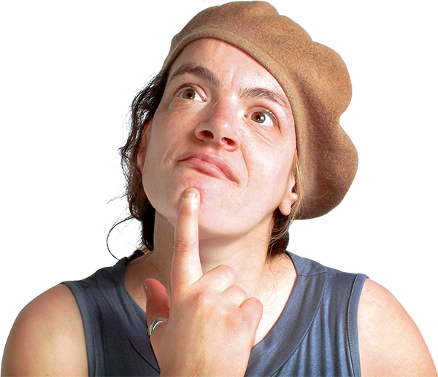
To make the Learning Disability Partnership Board a strong and influential Board I would …...

