Slide 1
Children & Young People (Mental Health, Learning Disability and Autism) Inpatient Services
Learning Disability workshop
11th July 2024
Notes:
Standard title slide

Slide 2
Welcome and Housekeeping / Ground Rules
Introductions from NHS England Specialised Commissioning and Quality Transformation team
The session will be recorded
To capture ALL attendees present, please type the following into the chat:
1- Name
2-Job Title
3-Organisation
Please wait until the end to ask questions
We will be using breakout rooms during the session.
Please use the ‘raised hand’ as far as possible to ensure everyone has the opportunity to speak and contribute
Listen to others when they are speaking and don’t interrupt
Be respectful in terms of challenges, and different opinions they are all important

Slide 3
Aims of this event
Sue North/ Anne Worrall-Davies

Slide 4
Family's voices
Mary Busk & Sahil Dodhia

Slide 5
What we know – Presentation of slides
Naomi Price

Slide 6
Current Commissioned Capacity
Host Region | Host Provider Collaborative | Provider | Unit | Total Commissioned Beds | Available Beds | Closed Beds | Closure Reasons | Bed Occupancy (%)
Midlands | West Midlands SMHPC (CYPMHS Tier 4) | Coventry And Warwickshire Partnership NHS Trust | Brooklands Hospital | 12 | 0 | 0 |  | 100.0
North East And Yorkshire | North East And Cumbria Specialist Services Partnership SMHPC (CYPMHS Tier 4) | Cumbria, Northumberland, Tyne And Wear NHS Foundation Trust | Ferndene | 4 | 0 | 4 | Other - please state (closed) (4), Patient acuity - Multiple patient acuity (3) | 0.0
London | North West London SMHPC (CYPMHS Tier 4) | Central And North West London NHS Foundation Trust | Kingswood Centre – Crystal House | 5 | 5 | 0 |  | 0.0
North East And Yorkshire | South Yorkshire SMHPC (CYPMHS Tier 4) | Sheffield Children's NHS Foundation Trust | The Becton Centre | 7 | 5 | 0 |  | 28.6
Total |  |  |  | 28 | 10 | 4 |  | 50.0
Location Region | General Adolescent LD
North East And Yorkshire | 11
North West | 0
Midlands | 12
East Of England | 0
London | 5
South East | 0
South West | 0
Location Region Totals | 28

Slide 7
CYPMH LD GAU Bed Occupancy Source: CPMS
Notes:
"Data downloaded from Capacity Planning and Monitoring System (CPMS). Occupancy Rates are grouped by month. SOP for updating this is contained in Restricted Library\4. MH data and analytics\10. Standard Operating Procedures (SOP)\CYPMH Scorecard SOPOccupancy Rates are calculated as ((Total Beds - Closed Beds - Available Beds) / Total Beds)."

Slide 8
Total Number of Admissions by Service Category by Month
Data Source: NCDR/MHSDS
Total Admissions by Service Category

Slide 9
NCMS Data Exclusions/Issues/Caveats
Exclusions / Issues / Caveats:
This data has been sourced from the National Case Management System
Any issues regarding data quality should be addressed with the LPC Case manager who is responsible for maintaining this system
Admissions attached to the GAU LD service line were analysed
We have not analysed all patients with an LD in other service lines
Admissions over the last 4 years and current admissions were included
In June 2024 AT was aligned with NCMS allowing us to report on disabilities – data quality will be affected by this for historical cases.

Slide 10
NCMS GAU LD Data headlines
In the current admission cohort 66% have ASC as a co-morbidity
Males are overrepresented in admissions
Majority of admissions are detained under Section 3 of the MH Act
Child in need plans are more prevalent in current admissions
Current patients are more ethnically diverse
Current patients originate from localities that have GAU LD beds
Over the last 4 years most patients originate from the NE&Y – the only region with 2 GAU LD services historically.
Children as young as 8 have been admitted to these services

Slide 11
NCMS Current admissions
4/9 patients are reported as delayed discharges
44% are reported to have ASC and LD intellectual disabilities
66% are reported to have ASC as a co-morbidity
Unlike GAU services currently there are more Male admissions
LOS 108 days-1235 days
Average distance from home 38.3 miles
Majority are detained on S3- MHA
56% are reported as on a child in need plan (S17)
Average age for admission was 14.5
Current patients age from 11-17
Notes:
Distance from home and diagnosis – age range

Slide 12
Current patient demographics continued (27.6.24)

Slide 13
NCMS Admissions to GAU LD 27/6/2020 -27/6/24
76 admissions recorded on NCMS
75% were reported as White British/white other
37% reported to have ASC and LD intellectual disabilities
25% are reported to have ASC as a co-morbidity
64% of admissions were for males
Average LOS reported as 158.5
Range of LOS is 7 days-1235 days
Average distance from home 35.5 miles
48% are detained on S3- MHA
11% reported as Looked after children
28% are reported as on a child in need plan (S17)
Average age for admission was 14.43
Childs age at admission ranged from 8-17
60% of admissions originate in NE &Y
Notes:
Distance from home and diagnosis – age range

Slide 14
All admissions patient demographics continued (27.6.24)

Slide 15
New model principles – Presentation of slides
Sahil Dodhia

Slide 16
Current Inpatient CYPMH Services
Tier 4 services include both inpatient and day placement services to provide care and treatment for CYP with a mental illness.
The average length of stay is almost 4 months.
.
Local areas are working hard to develop and maintain admission avoidance schemes, including crisis houses, day placement provision and strengthening community teams.
Young people in Learning Disability and Autism services have an average length of stay of almost 8 and a half months.
£707
There are eight non-forensic service lines within CYP mental health services, with GAU making up half of the bed base.
Even in a non-forensic service line, someone may be admitted under the Mental Health Act 1983.
The average daily cost of a CYP mental health inpatient bed.
There is an under-representation of Asian
and Asian British CYP in inpatient mental health services.
Community teams provide intensive and crisis care to young people in the community, and can support discharge from inpatient services
Activity levels are high, with 2,700 admissions in 2022/23, 2,600 CYP admissions in 2021/22 and 3,750 in 2020/21.
.
The national ambition is to reduce lengths of stay and ensure that children and young people are cared for as close to home as possible.
There is a universal referrals form used to access CYP inpatient services.
Girls are overrepresented in inpatient mental health services.
Data source: NCDR
Notes:
Plain slide with subhead and bullets

Slide 17
Facilitated workshops with provider collaboratives and clinicians
Visited inpatient services
Developing the Review
Listened
to people with lived experience of inpatient services, staff, families and carers
Reviewed
the evidence base

Slide 18
Local Mental Health Centre
Commissioning arrangements
Interventions therapies & activities
Key Recommendations
Enhanced Specialist Community Services
Workforce
.
Involvement and co-production
Assessment & Decision Making
Environment
.

Slide 19
What we heard from young people, parents & frontline staff

Slide 20
Access to support earlier
Intensive home support
Key worker / one person to follow the YP
Crisis beds
Family support
Young people with an eating disorder to be supported in general hospitals
Peer support
Appropriate assessment at point of admission
Alternatives to hospital

Slide 21
Therapy not just ‘formal’ therapies
Fun
Appropriate activities
Available 7 days a week
Access to education
Involved in care planning
Trauma informed
Person centred
PBS – shared
Family focused
Interventions, therapies & activities

Slide 22
Culturally competent
Caring, kind compassionate
See children & young people as person not ‘illness’ / label
Peer Support
Clinical Leadership
Visible Leaders
Family Ambassadors
Trained and skilled
Access to supervision and support
Children & young people at the centre of everything.
Staffing

Slide 23
Shared decision making – children & young people and family
Gatekeeping
Listen and HEAR what children & young people are saying
Stop the repetitive assessments – Golden Thread
Whole family approach
Joined up across health, social care and education
Personalised
Assessment & Decision Making

Slide 24
Space and colour important
Areas for de-escalation – not seclusion
Importance of sensory friendly –lighting, doors
Balanced between ‘homely’ and clinical
Less restrictive
Clean
Education accessible
Sense of ‘normality’
Environment

Slide 25
Reducing restrictive practice
Stop blanket rules that make no sense
De-escalation rather than restraint
Increase staffing levels
Follow PBS
Stop ‘blaming’ & ‘criminalising’ children & young people
Positive risk taking
Personalised care and treatment
Share information with families

Slide 26
We also set out to
Recognise
That many mental health inpatient services across the country are delivering good care and outcomes.
Gather
The knowledge and expertise across the country & showing what is possible and achievable.
Harness the good stuff!

Slide 27
ALL means ALL
The NHS Constitution for England states:
The NHS provides a comprehensive service, available to all.
It is available to all irrespective of gender, race, disability, age, sexual orientation, religion, belief, gender reassignment, pregnancy and maternity or marital or civil partnership status.

Slide 28
A service for all Children, Young People & families, for all mental health presentations & needs
New service functions
As a result of a whole system review, a new model has been developed for children and young people's inpatient care.
Delivering smaller, more local inpatient wards within Local Mental Health Centres – including provision for High Intensity Areas (previously PICUs).
To enable more children and young people to be supported at home (and to return home sooner after hospital admission), some resources will be refocused to deliver alternatives to inpatient admissions. This includes:
Day Services
Intensive Support Service (providing home outreach)
Consultation and Advice Service (providing team-around-the-professional support and second opinions).
Consultation and Specialist input
Intensive Support Service
Day Services
Local Mental Health Centre - Inpatients
One workforce/ service for the whole provision

Slide 29
Key Messages
To support local system with the mobilisation of service change that will enable the provision of high-quality services
Specialist expertise which follows the CYP throughout their journey offering continued and consistent support for CYP and their network
Specialist home treatment function to provide a more responsive and targeted support to enhance community provision
Need to ensure that transformed services meet the needs of every CYP who needs to use specialist services including CYP from racialized communities and those CYP with a learning disability or / and are autistic
Meet the needs of children and young people who have a mental health need AND who have a learning disability and / or are autistic, through ensuring that the therapeutic interventions are adapted to support the mental health needs of the young person in the context of being autistic or having a learning disability.
The inpatient and specialist home treatment elements of the service should function as one team
Move away from specialist expertise being located in separate inpatient services which requires frequent Out of Area care, to the specialist expertise following the child. This will enable Local inpatient centres to be aligned to the local care pathway and keep Children and Young People connected to their home and community
There needs to be strong focus on maintaining therapeutic relationships with someone the children and young people have already formed a trusted relationship with.

Slide 30
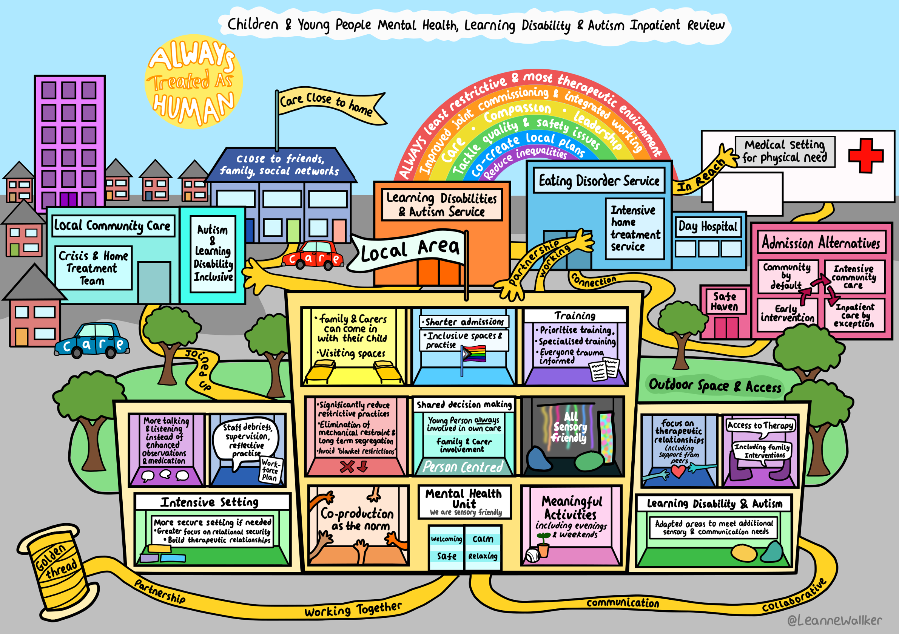

Slide 31
Predicted CYP Intensive Mental Health Service milestones
June 24
Service specification out for Stakeholder testing (4 weeks)
September 24
April/May 25
Service specification out for public consultation (90 days)
Service specification
published on website
June 25
New QNIC standards
Published?
March 25
CYP Intensive Mental Health Service guidance published on website
Dec 24/Feb 25
Sharing of tools, case studies etc via futures

Slide 32
Comfort break
10 minutes

Slide 33
Breakout rooms
Breakout room questions: What aspects of the proposed new model are likely to help this group of children, young people and their families and how can we address any areas that might result in unintended consequences for them? What do you think are the key enablers and solutions to achieve this. Given the principles of the proposed model, in terms of developing intensive community support as an alternative to admission, what can we do to ensure that this group of young people and their families receive the right support – what else / different / additional adjustments do we need to make to these services for these YP and their families. Workforce is key to supporting all young people in the proposed model, for this particular group of young people what do you see as the key areas that we need to focus on to ensure that staff are supported to drive improvement in the quality of care.
We will be sending you all into break out rooms.
Due to the number on this call we will have several rooms but will be covering the same three questions in every room.

Slide 34
Feedback
The facilitator from each room to feedback on one key point from their room.

Slide 35
Any Questions? Next steps & Close

